Slide 1

SE Unit2 Project – YADA
(Yet Another Diet Assistant)
Team 3
Bhavana Gannu
Padmalata Nistala
Arpita Gupta
Ranjith Raj
AVS Murthy

Slide 2

Agenda
1
YADA– Requirements
2
Design – UML Class Diagram
3
Classes - Responsibilities
4
Design - Salient Points
5
Implementation

Slide 3
1. YADA – Functional Requirements
Food Items
Add, update, Delete basic food items with basic attributes – identifier, keywords, calories (UI)
Add, update, delete composite food items with basic attributes (UI)
Create composite food by selecting one or more basic or composite food items with one or more qty.
Ability to search for basic or composite food item based on key words provided
Load basic and composite food items from database files on program start
Save basic and composite food items at program exit
Download food items information from standard web sites
User Profile
Create user profile with basic information
Maintain age, weight, activity level information on a daily basis for user
Update age, weight, activity level information on a day by user as needed
Selection of target calorie intake method by User

Slide 4
1. YADA – Functional Requirements
User Food Log
Maintain log of food consumed on a daily basis for user
Load user food log from database for a specific user
Add, delete entries from food logs for a specific date by selecting food items through search
By default carry over previous day’s log record for current day.
Undo option for user commands for log activities
Reporting
Generate day wise food log report for a user for a time period (from date, to date)
Format of day wise food log report – User, date, total calorie consumed, target calorie intake, difference between target and consumed.
Maintain databases
Basic food items
Composite food items
User profile
User daily food log

Slide 5
2. YADA – Non Functional Requirements
Maintainability
To be able to add additional attributes to basic and composite food items (e.g. nutrition information)
Interoperability
Read and write food and log data to text files (csv)
Ability to extend for downloading of food information from web sites
Adaptability
To be able to choose target calorie intake method for calarie computation
Performance
Managing size of log files
Security
User registration feature – to be added (later)
Accountability of transaction create, update, delete (later)

Slide 6
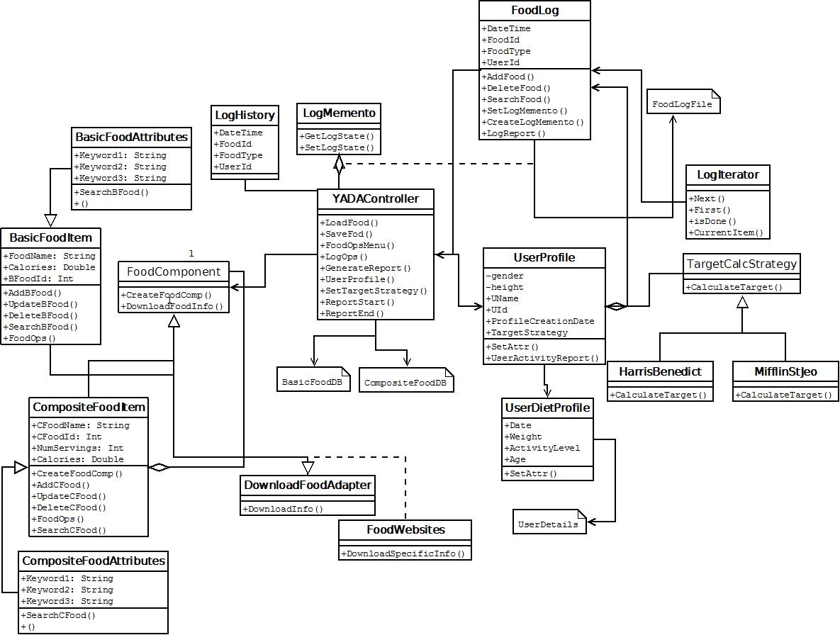
3. Design – UML Diagram

Slide 7
3. Classes - Responsibilities
Class | Responsibility
YADAController | Main controller class, which gets invoked first during execution Provides the user interface to select options Initiate Load files from databases, Save files to database, Initiate generate report
UserProfile | Provides basic profile of user
UserDietProfile | Provides Diet profile of user for a day – weight, activity level…
Food Component | Composite pattern – can have basic or composite food items as food components
Basic Food Item and Basic Food Attrs | Basic food items and corresponding attributes
Composite Food Item and Composite Food Attrs | Composite food items and corresponding attributes
Download food adapter and Food Websites | Adapter pattern - To provide interface for creating food items components from food webs sited through DownloadFoodAdapter.
Food Log | Maintains log of food consumed by user – date wise
Log Iterator | Iterator pattern – To traverse user log collection
Target Calc Strategy, | Strategy pattern – To facilitate selection of target calorie intake method by User
HarrisBenedict, MifflinStJoe | Specific algorithm implementations
LogMemento, LogHistory | Memento pattern - To provide undo option for user commands(log)

Slide 8
4. Design - Salient Points
Pattern | Responsibility
Composite Pattern | Food component creation-can have either basic or composite food items.
Strategy Pattern | To allow for selection of algorithm for target calorie computation and to have flexibility to add more algorithms to design at a later point.
Adapter Pattern | To have flexibility to add interfaces for downloading food information from websites and populating to food items.
Iterator Pattern | To traverse the log collection for a user for a specific date.
Memento Pattern | To provide facility to undo log operations by users
Target Calorie Algorithms | Description
HarrisBenedict | A concrete calculator that calculates target calorie intake using Miffin-St Jeo Algorithm.
MifflinStJoe | A concrete target calorie calculator. Uses Harris-Benedict Algorithm.

Slide 9
4. Design - Salient Points
Databases - Maintained as csv text files
UserFoodDB
BasicFoodDB
CompositeFoodDB
UserLogDB - this file is maintained user wise and year wise - to manage the size of the log file.
Strengths
Leveraging of appropriate design patterns (Strategy and Adapter) to provide flexibility and maintainability.
Tried for high cohesion and loose coupling in class design
Traceability of identified functional and non functional requirement in design
Weakness
Security requirements identified but not implemented for prototype. Security is weak and needs to be built into the design.
Primitive user interface is provided from command prompt. Can be improved.

Slide 10
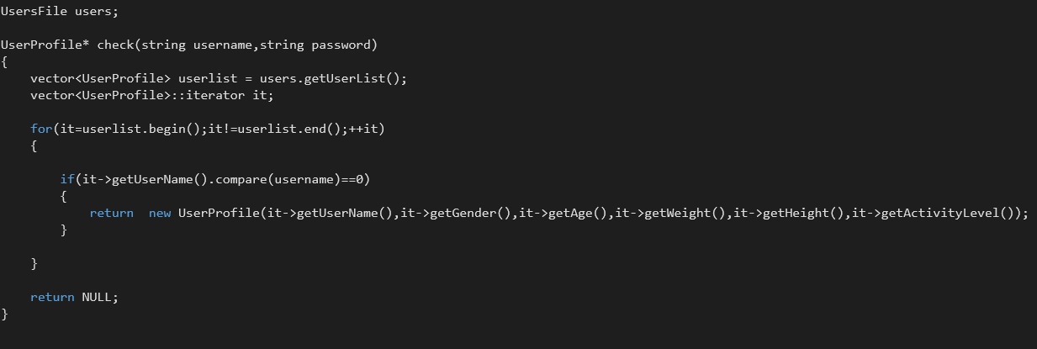
5. Implementation
Programming Language: C++
● Database: Text Files

Slide 11
Thank You

